Slide 1

Demo Session for ETABSPY
New Python-Based Design Aid Tool
Tech Committee 2026
Efficiency Improvements Focus Group

Slide 2
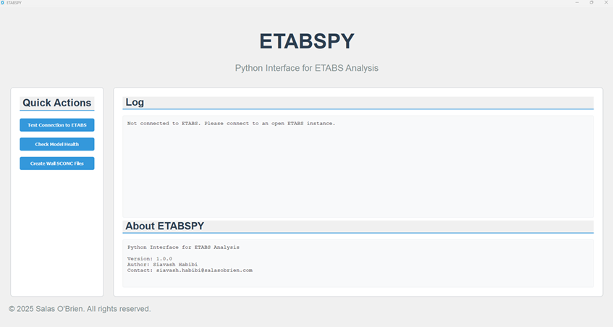
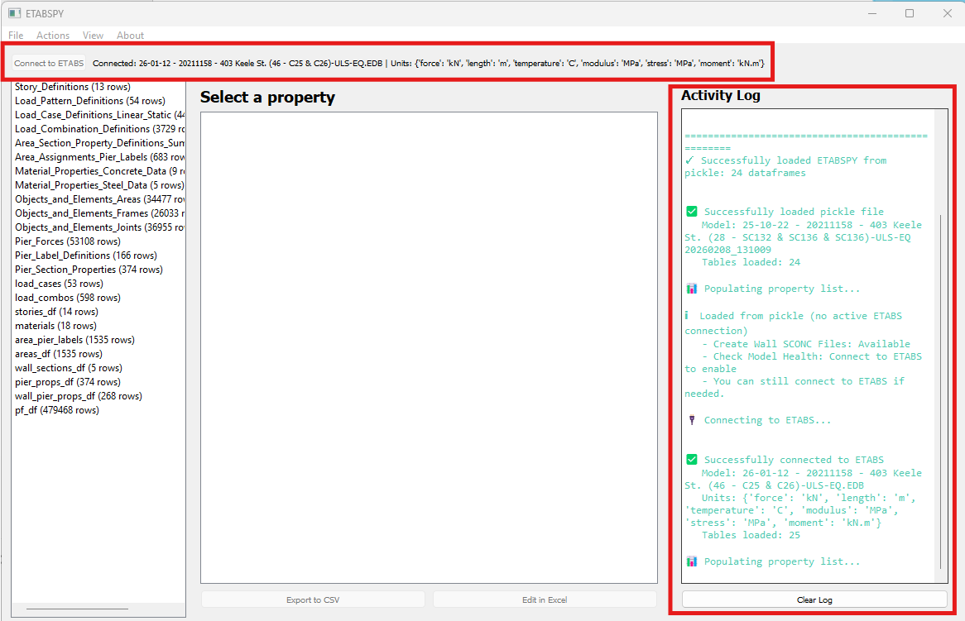

ETABSY V1.0 Refresher
Improvement to API calls and data loading method from ETABS to prevent software crashing for large files
UI overhaul with more granular control
Click here to learn how to create a custom cover for this presentation.
Photoshop is required.

Slide 3
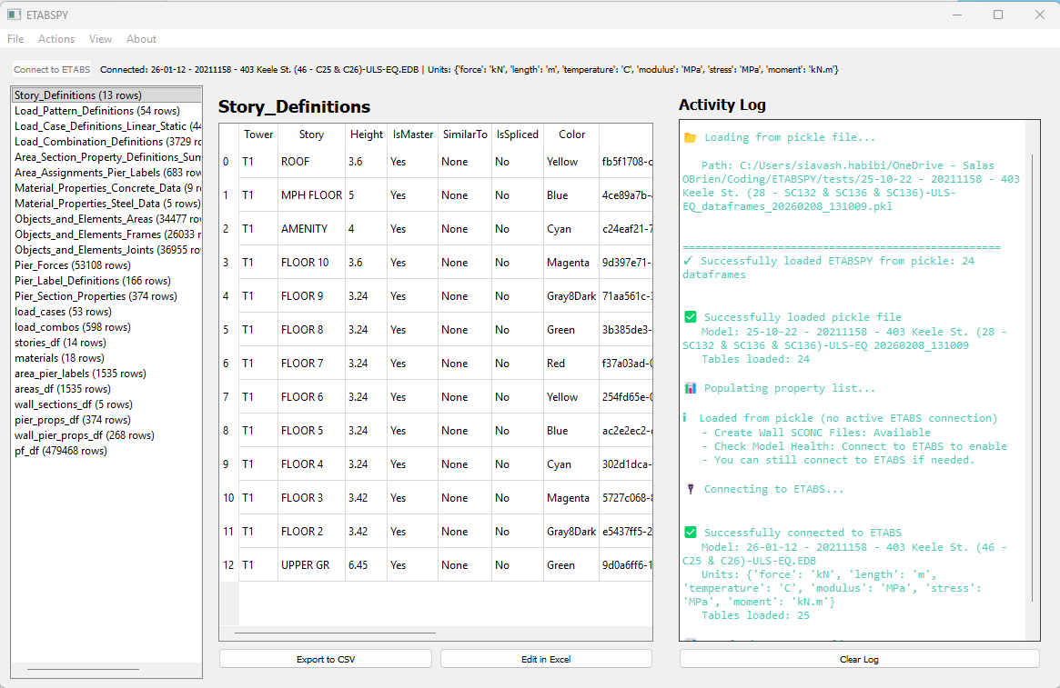

ETABSY V2.0
New Features: Table Viewer with export to CSV or Edit in Excel button
Ability to save and load previously loaded ETABS models without reconnection to ETABS
Click here to learn how to create a custom cover for this presentation.
Photoshop is required.

Slide 4
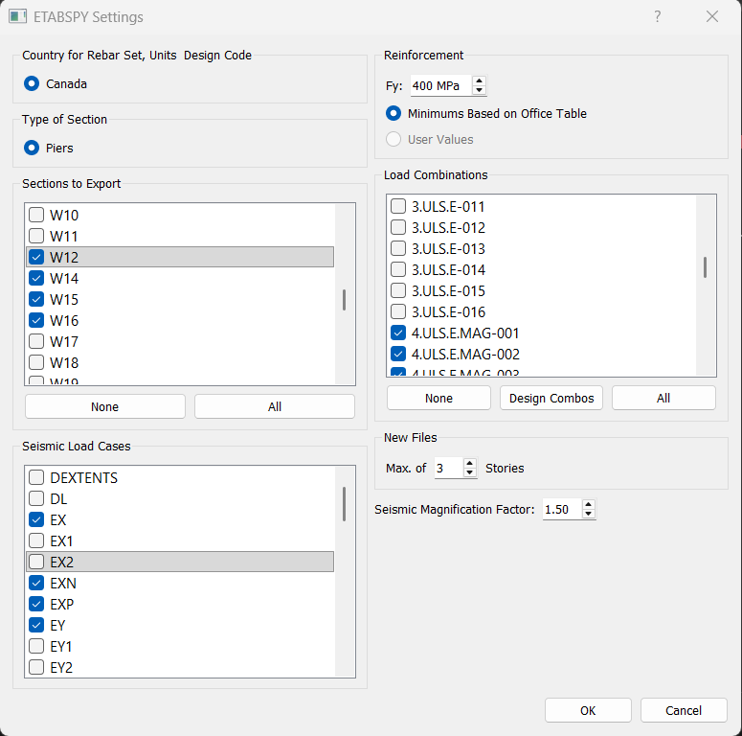
Settings
Settings Dialog to control load combinations and pier labels to be included in the SCONCRETE files.
Identical to previous ETABS to SCONCRETE tool.
Click here to learn how to create a custom cover for this presentation.
Photoshop is required.

Slide 5
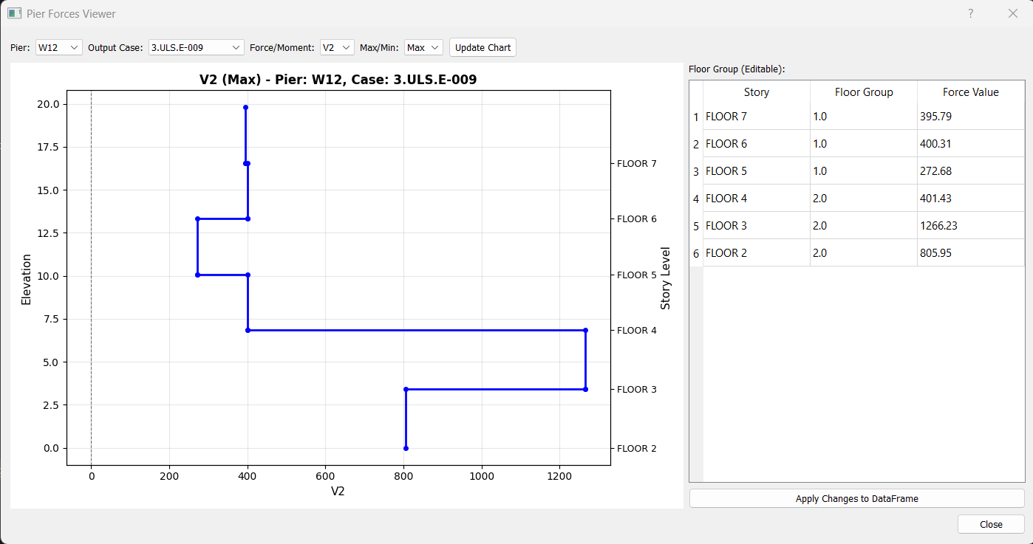
Pier Forces Viewer
Control the creation of SCONCRETE files based on Floor Group column
Click here to learn how to create a custom cover for this presentation.
Photoshop is required.

